Slide 1
TEAM A · DATA MINING · INNOPOLIS UNIVERSITY
High-Growth
Repositories
Detection
Early detection of GitHub stars before they shine.
May 2026
Notes:
Hi. We're Team A. Our project is called High-Growth Repositories Detection. Let me start with one example.

Slide 2
DECEMBER 2023 → JUNE 2024
9
1,004
→
stars in six months
linyuchen / LiteLoaderQQNT-OneBotApi · flagged by our model in advance
02 / 14
Notes:
This repository had nine stars in December twenty twenty-three. Six months later — over a thousand. Whoever found it early had a six-month head start. Could a machine have flagged it in advance? That's what we built.

Slide 3
The problem
GitHub has a hundred million repositories.
Thousands are created every day. Most never get traction.
Investors, recruiters, and developer-tools companies want to find
the small fraction that will succeed —
before they go mainstream.
Existing tools rank by current popularity. By then, the early window is closed.
03 / 14
Notes:
GitHub has more than a hundred million repositories. Most never get traction. Investors and recruiters want to find the small fraction that will. Existing tools rank by current popularity — by then the early window is closed.

Slide 4
Why anomaly detection
✗
Classifier
✓
Anomaly detection
Needs labels at the time of prediction.
At T we don't yet know who succeeds.
Using future data to train = leakage.
Asks: which repos behave unusually now,
compared to three million peers?
No labels needed. Pseudo-labels validate post-hoc.
04 / 14
Notes:
We could train a classifier — but at T we don't have labels yet. Using future data is leakage. So we ask a different question: which repos behave unusually now? That's anomaly detection.

Slide 5
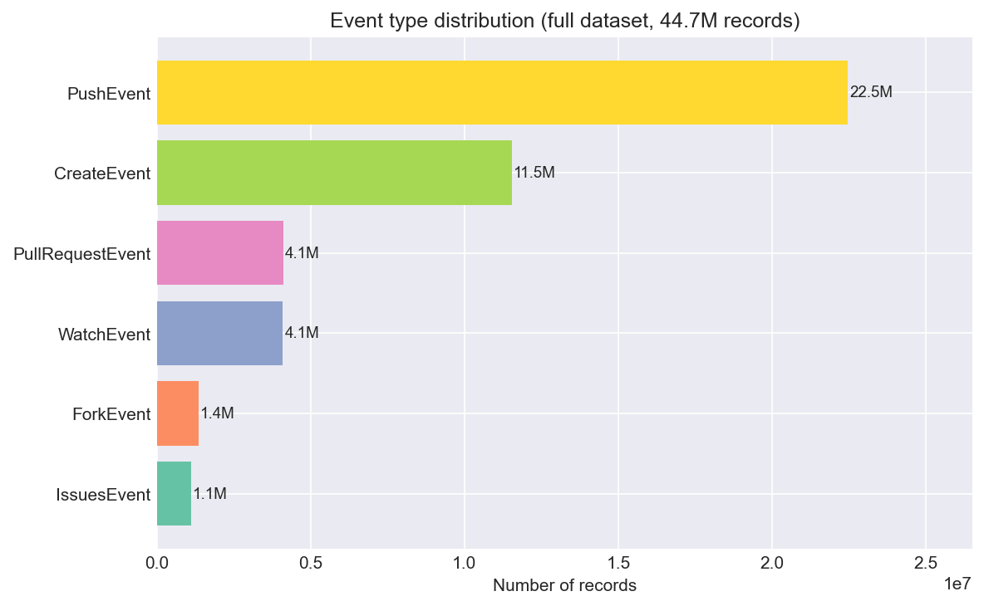
The data
44.7M
10.4M
18
event records
repositories
months
GH Archive via BigQuery · 10% sample · Jan 2023 — Jun 2024
05 / 14
Notes:
Eighteen months of GitHub activity — 44.7 million event records across 10.4 million repositories.

Slide 6
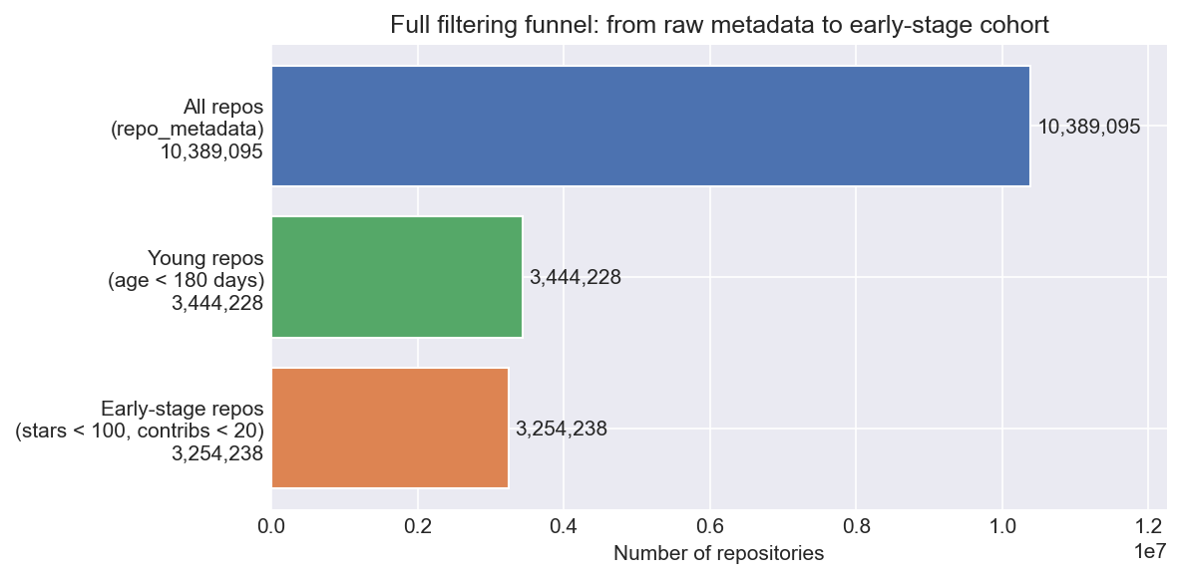
From 10.4M to 3.25M early-stage repos
T = 2024-01-01 · age < 180 days · stars < 100 · contributors < 20
06 / 14
Notes:
We freeze at T = January 1st 2024. From 10.4 million repos, we filter to 3.25 million early-stage.

Slide 7
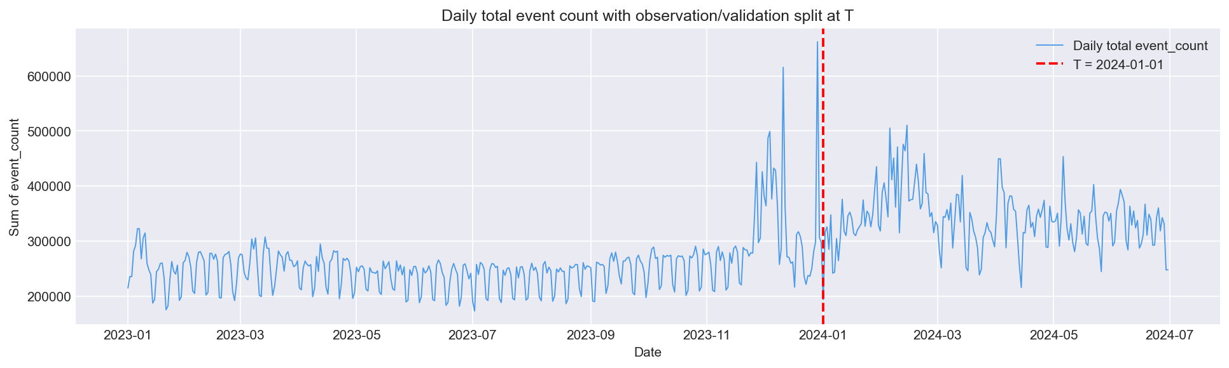
Feature window vs validation window
Features computed strictly before T. Success measured in 6 months after T. No leakage.
07 / 14
Notes:
Features come from before T. Success is measured after T. Strict separation.

Slide 8
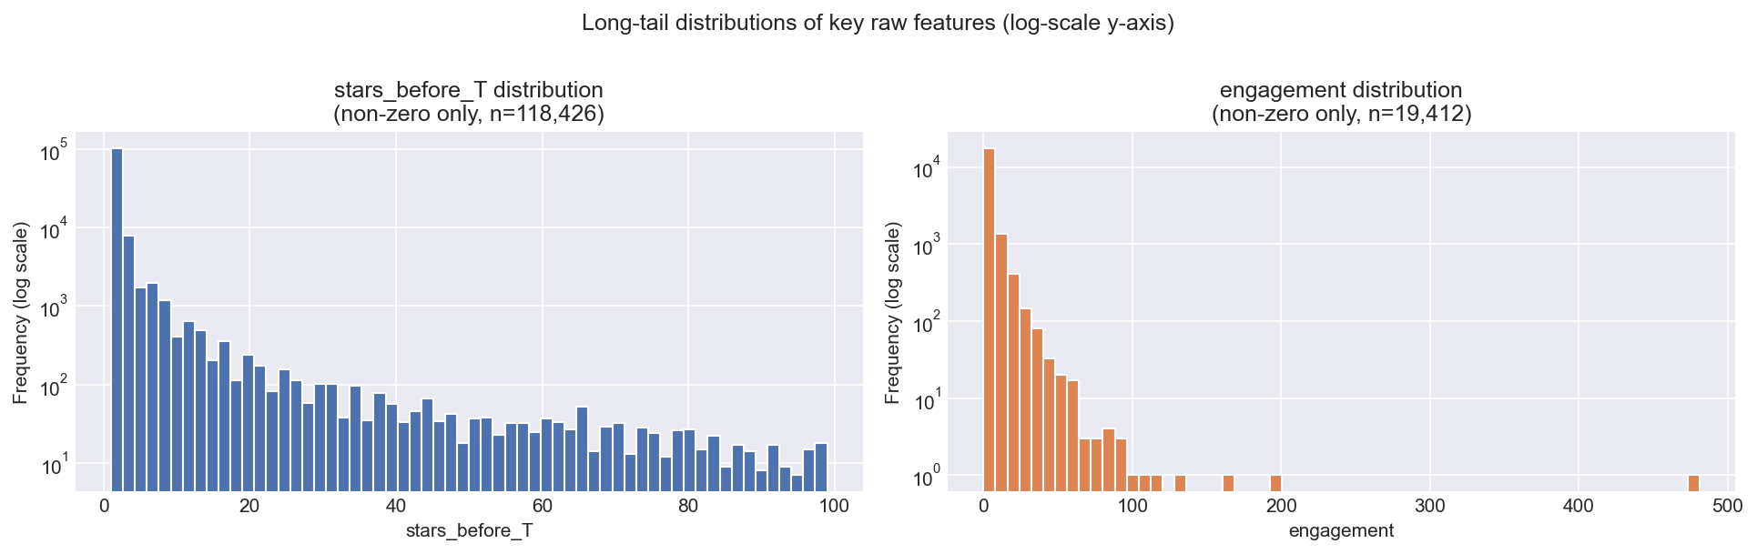
Long-tail signals — anomalies stand out
10 features per repo · 4 raw counts + 6 derived growth ratios
08 / 14
Notes:
Ten features per repo — four raw counts and six derived growth ratios. Most repos show near-zero values. The rare anomalies stand out.

Slide 9
Three detectors → ensemble vote
01
02
03
Isolation Forest
Local Outlier Factor
DBSCAN
Random partitioning
isolates outliers
Local density
vs neighbors
Noise points in
low-density regions
ROC-AUC 0.811
Catches local anomalies
48% precision
↓
ENSEMBLE
Flagged if at least 2 of 3 methods agree · 1,320 repositories
09 / 14
Notes:
Three detectors with different principles: Isolation Forest, LOF, DBSCAN. A repo is flagged if at least two of three agree. That's our ensemble — 1,320 repositories out of 3.25 million.

Slide 10
Results
SUCCESS CRITERION WAS 30% PRECISION · ALL THREE METHODS PASS
32.5%
197×
lift over random · base rate 0.17%
0.811
precision
Isolation Forest, contamination = 0.05
ROC-AUC · vs 0.620 baseline
DBSCAN: 48% precision · Ensemble: 45% · 2,871 repos flagged
10 / 14
Notes:
The success criterion was 30%. Isolation Forest hits 32.5%. DBSCAN — 48%. Ensemble — 45%. All three pass. Lift is 197 times over random selection.

Slide 11
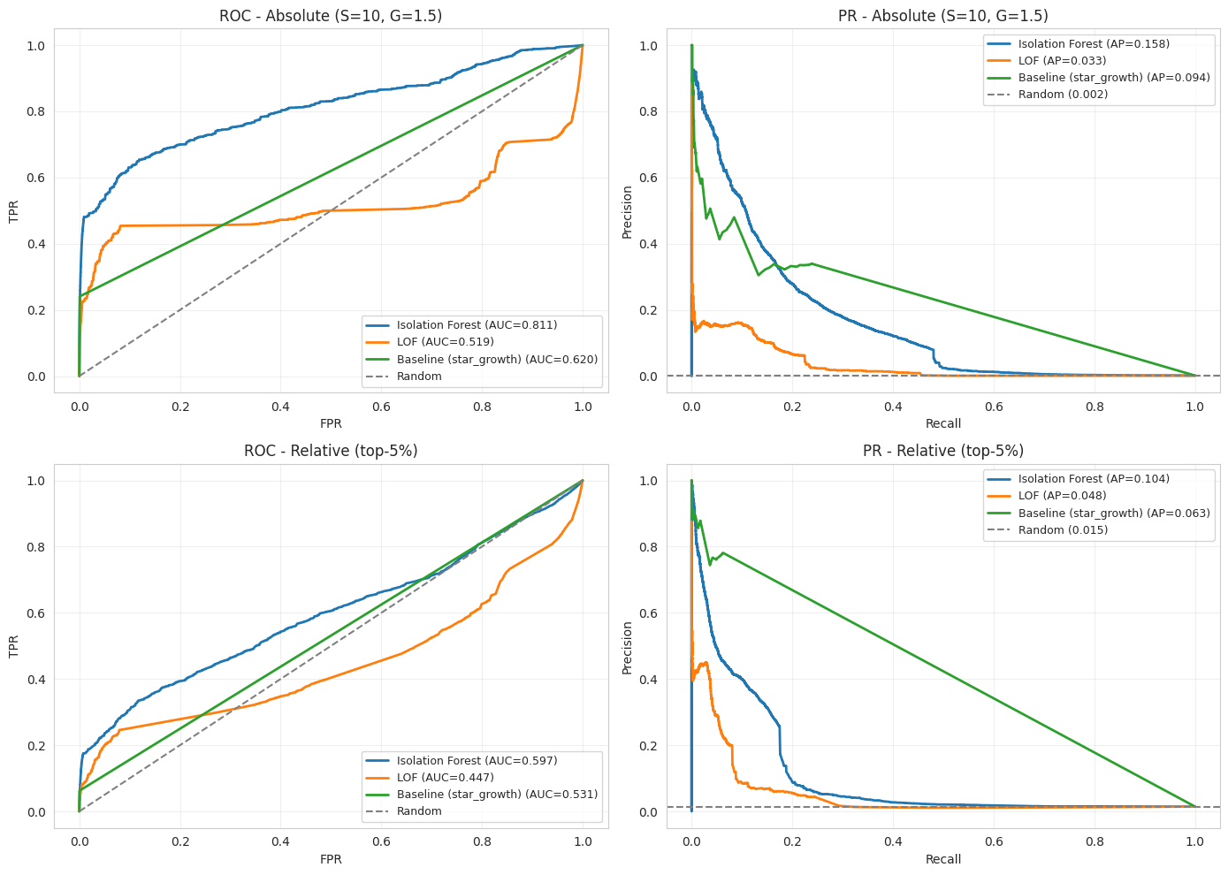
Top-ranked repos really do succeed
P@10
P@50
0.80
0.92
An analyst reviewing the top 50 IF-ranked repos finds ~46 future high-growth projects.
11 / 14
Notes:
Precision-at-K is the most actionable metric. At the top ten, eighty percent really did become high-growth. At the top fifty — ninety-two percent.

Slide 12
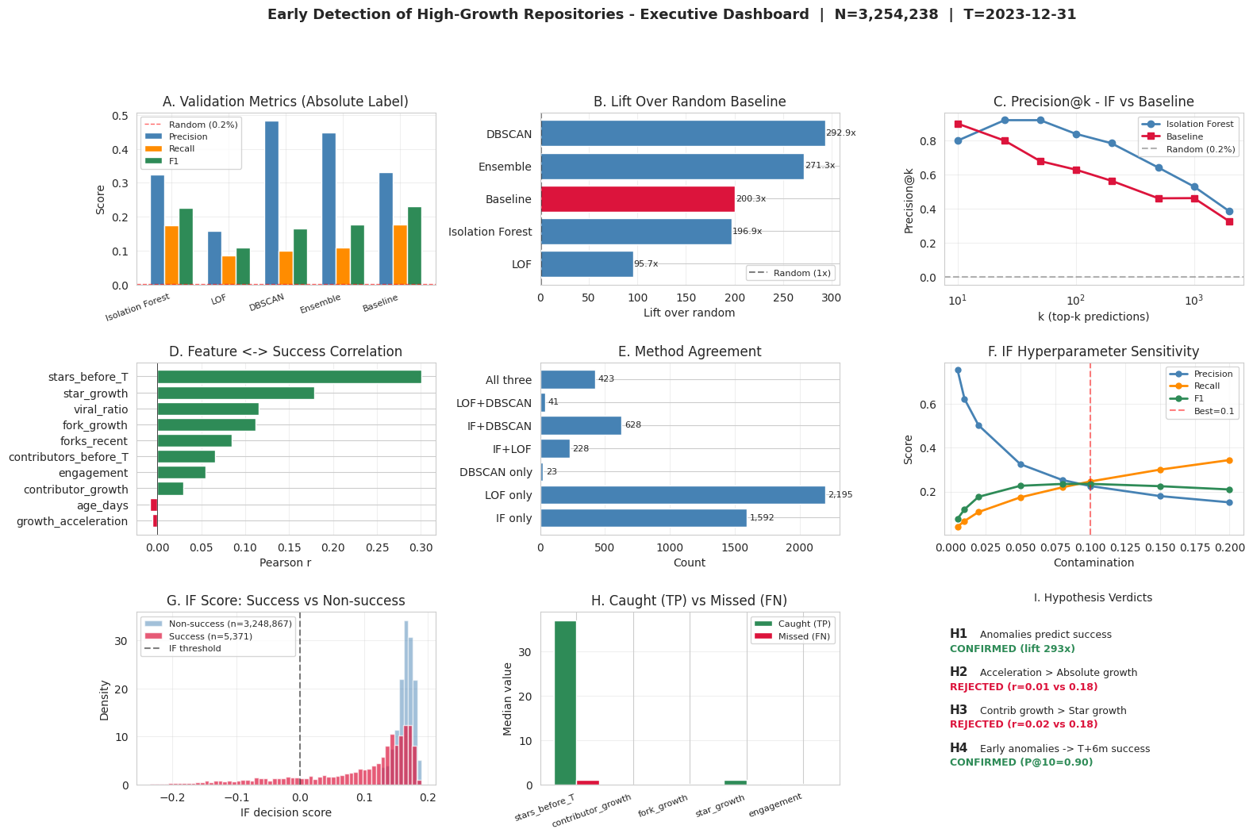
Real repos we flagged in December — exploded by June
12 / 14
Notes:
Real repositories our model flagged before T. Nine stars to 1,004. Fifty-seven to 799. Found in December — well known by June.

Slide 13
What this does NOT do
01
We catch early signals — not zero-to-one breakouts.
Repositories that grew from absolute zero have no pre-T signal. That's 89% of the successes we missed — a fundamental constraint, not a modeling failure.
02
Single-feature baseline matches our precision.
At fixed budget, a star_growth ranker achieves nearly the same precision. Our advantage is in ranking quality at short list sizes (P@k), not bulk classification.
03
The success label is a design choice.
Our threshold — ≥10 stars or ≥1.5× growth in 6 months — was calibrated to the data. Different thresholds give different numbers.
13 / 14
Notes:
First — 89% of successes start from silence and are undetectable from pre-T features. Second — the simple star-growth baseline matches our precision at fixed budget; our edge is ranking quality. Third — the success threshold is a design choice.

Slide 14
What's next · Team
Future work
Team A
Longer validation window (12–18 months)
Raw event data — true unique contributors
Replace LOF with HDBSCAN
Active learning on top-50 verified labels
Daily scoring deployment pipeline
Ildar Rakiev — Project Manager
Azalia Alisheva — Business Unit
Anisya Kochetkova — Data Scientist
Salavat Faizullin — Model Developer
Ilona Dziurava — Business Analyst
Thank you.
github.com/IldarRakiev/High-Growth-Repos-Detection
Notes:
Next steps: longer label window, raw event data, deployment pipeline. Code, data, and the full report at the GitHub link below. Thank you.

